Slide 1
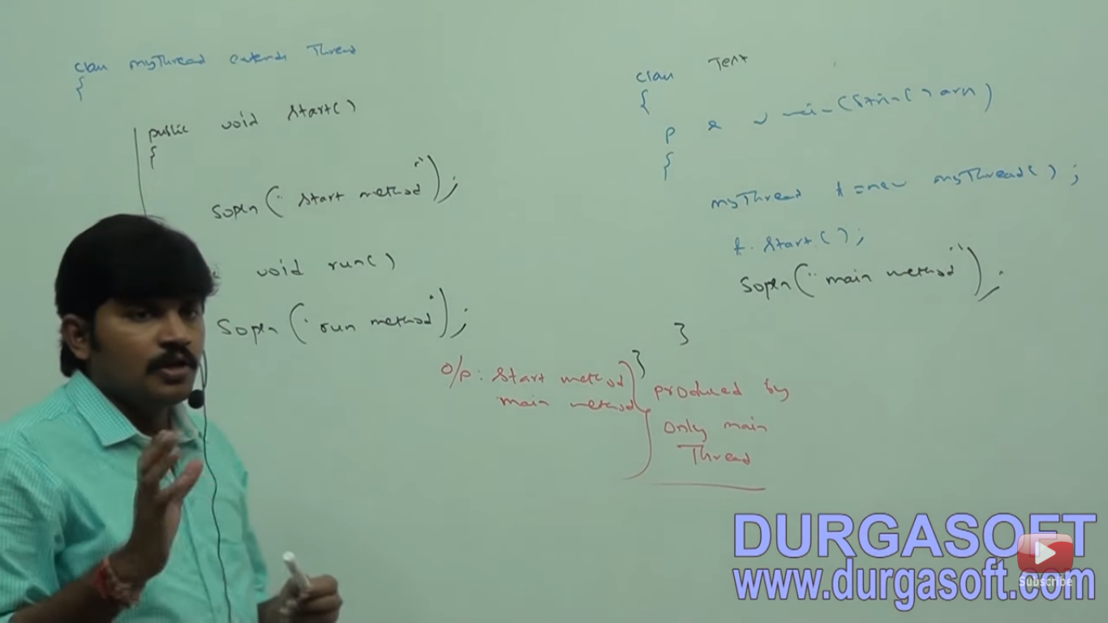

Slide 2
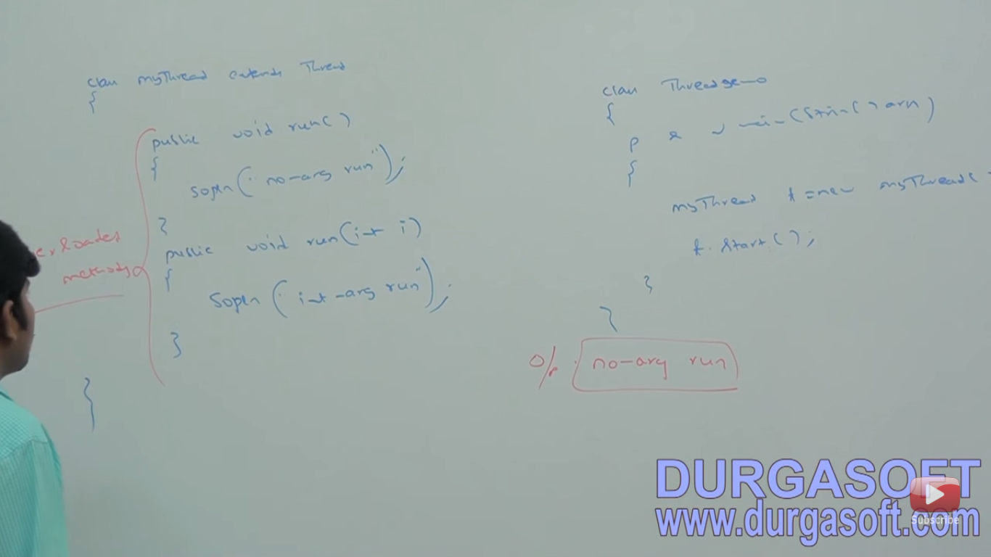

Slide 3


Slide 4
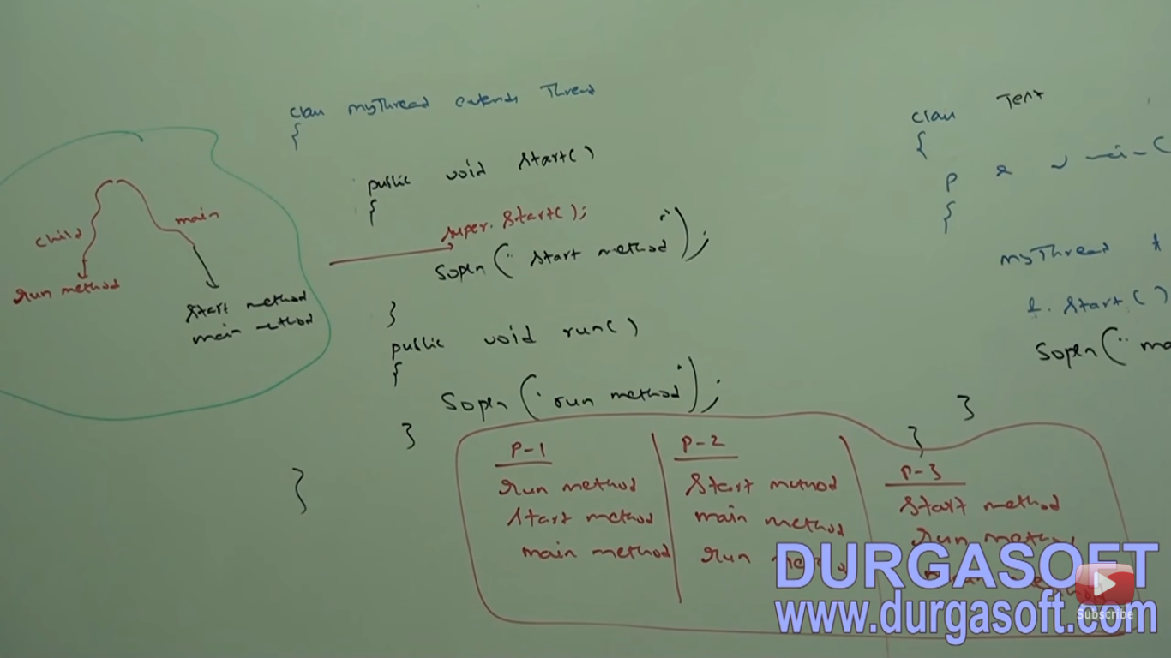

Slide 5


Slide 6


Slide 7
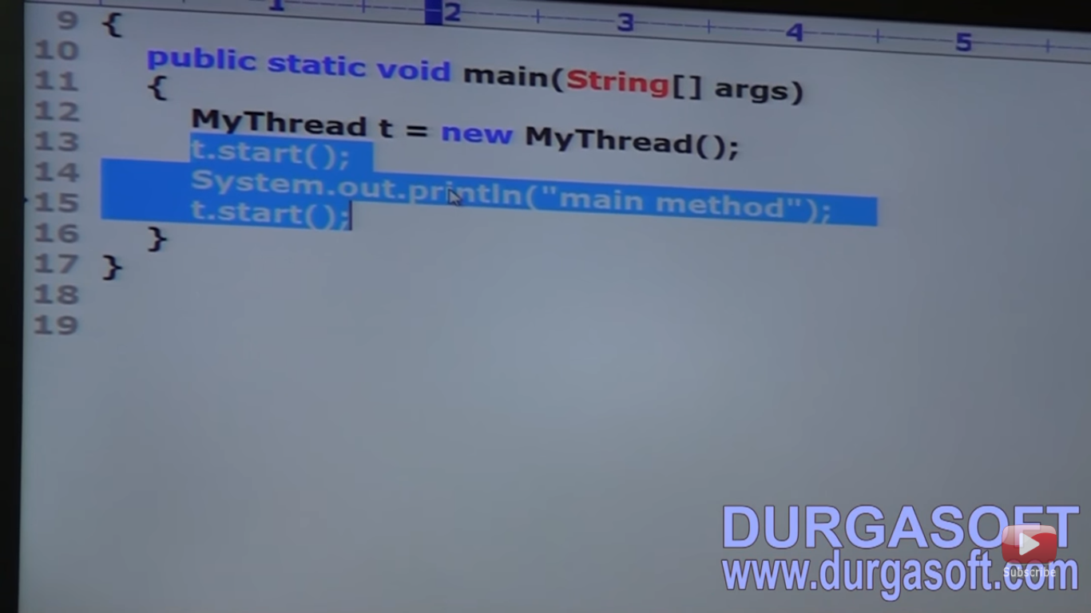

Slide 8


Slide 9


Slide 10
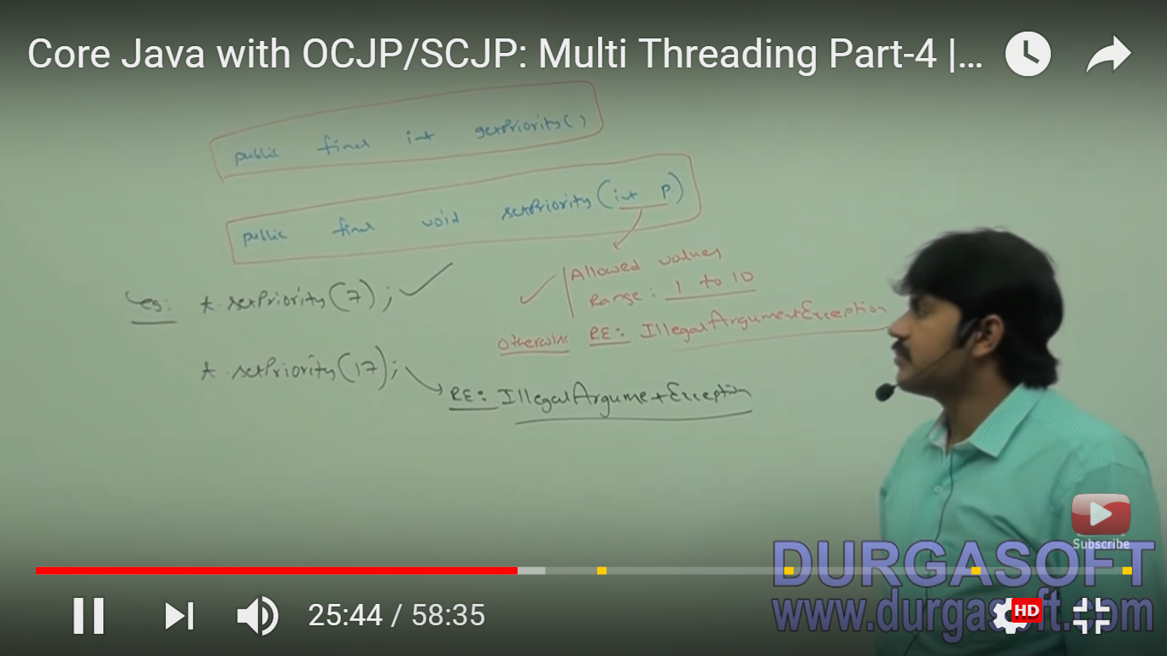

Slide 11
Thread priorities inherited by parent thread.

Slide 12


Slide 13
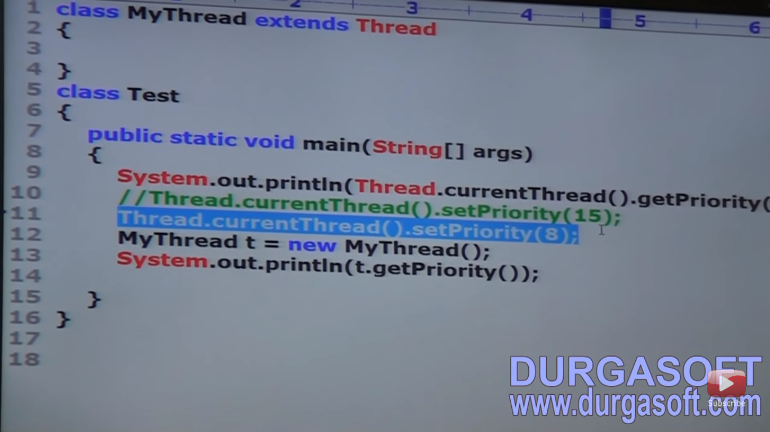

Slide 14


Slide 15
Some OS not supporting proper thread priorities.For that we need patch.

Slide 16


Slide 17
Yield()
If any thread wants to pause the execution and give chance to any remaining waiting thread of same priority.

Slide 18
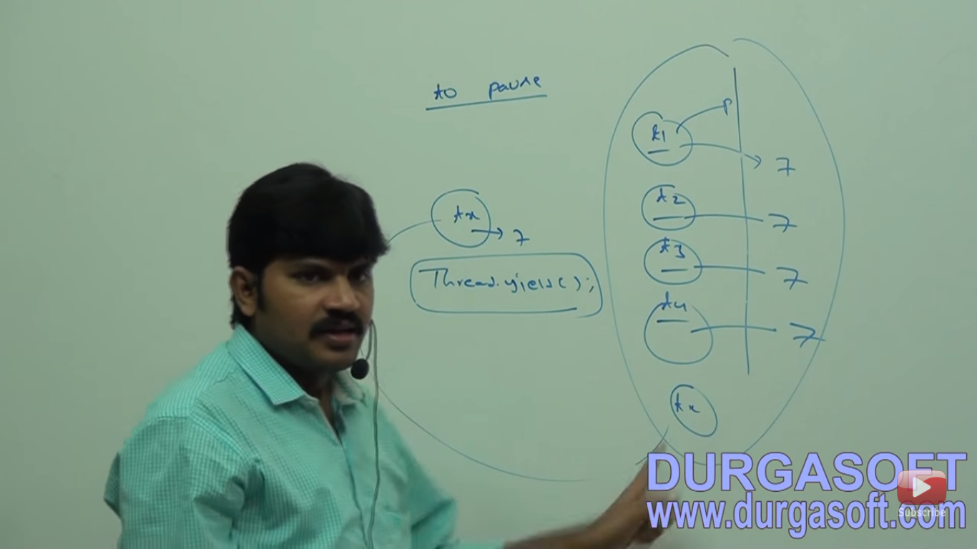

Slide 19


Slide 20


Slide 21
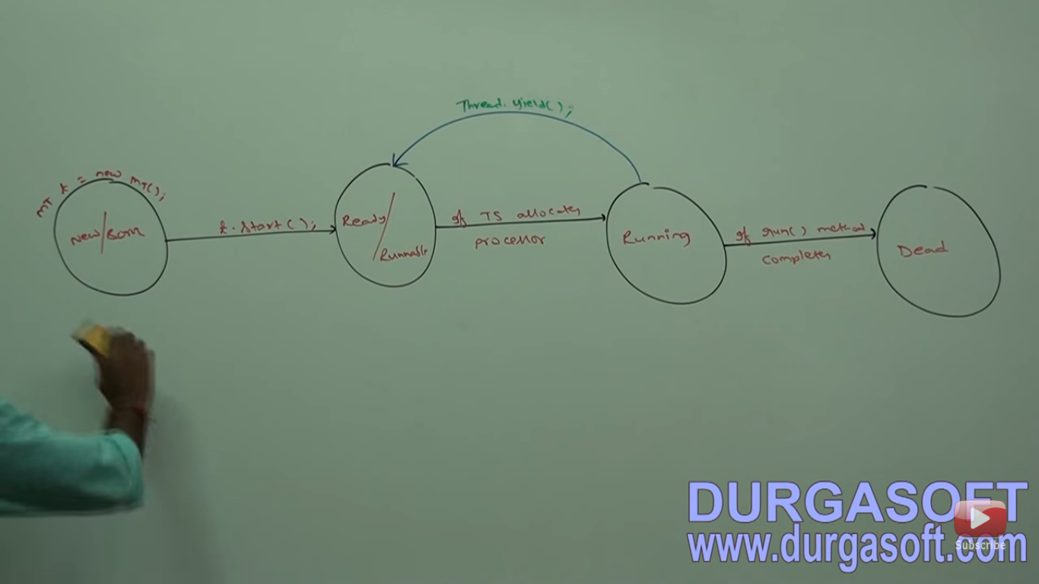

Slide 22


Slide 23


Slide 24
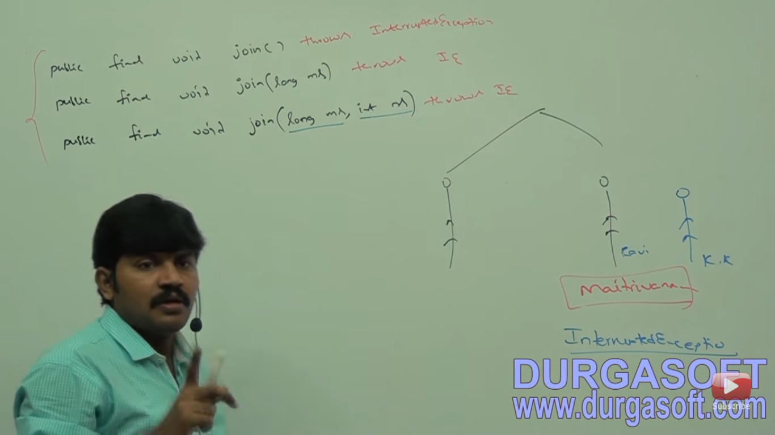

Slide 25
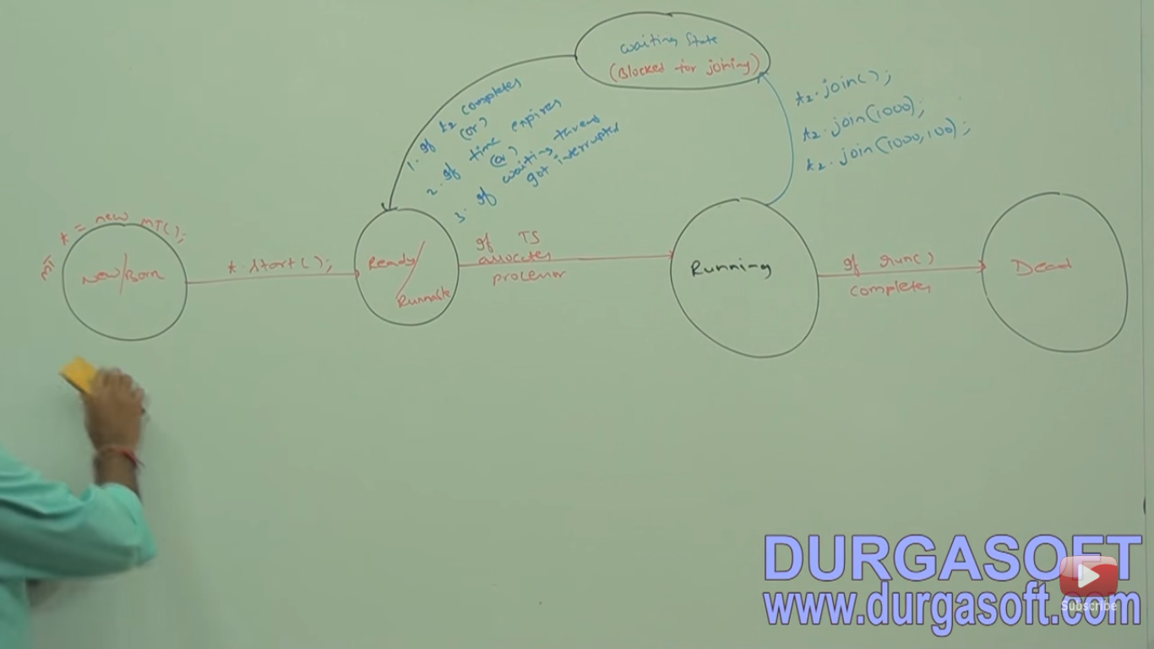

Slide 26
Join()
If a thread wants to wait until completing some other thread.

Slide 27
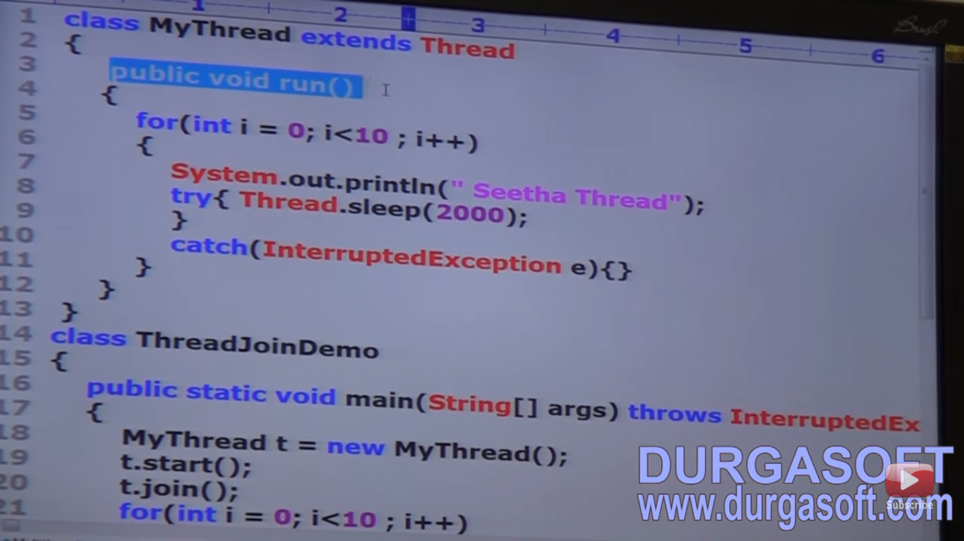

Slide 28
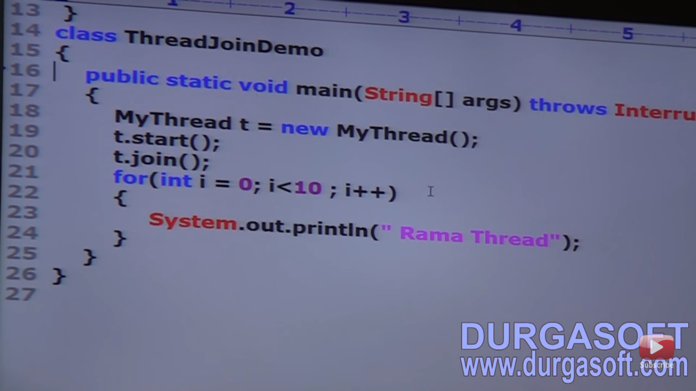

Slide 29
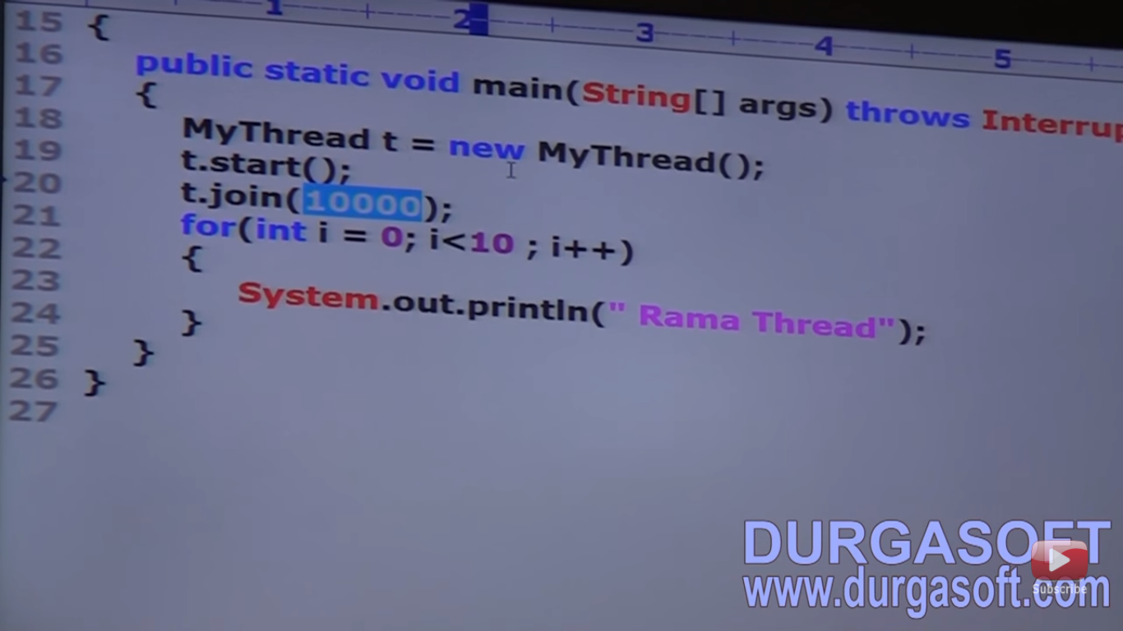

Slide 30
Use of Thread Based Multitasking
Increase performance
Reduce response time.

Slide 31
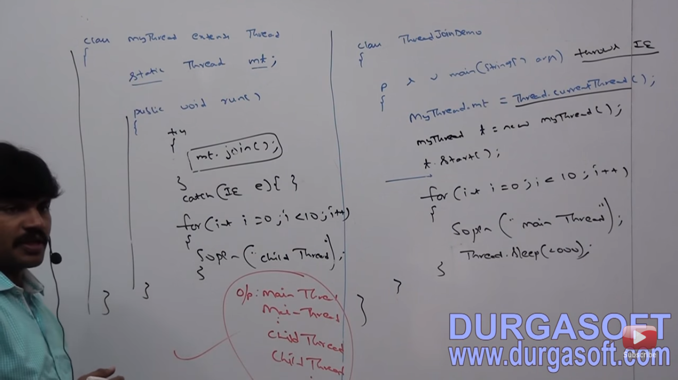

Slide 32
Deadlock program in next slide.

Slide 33


Slide 34
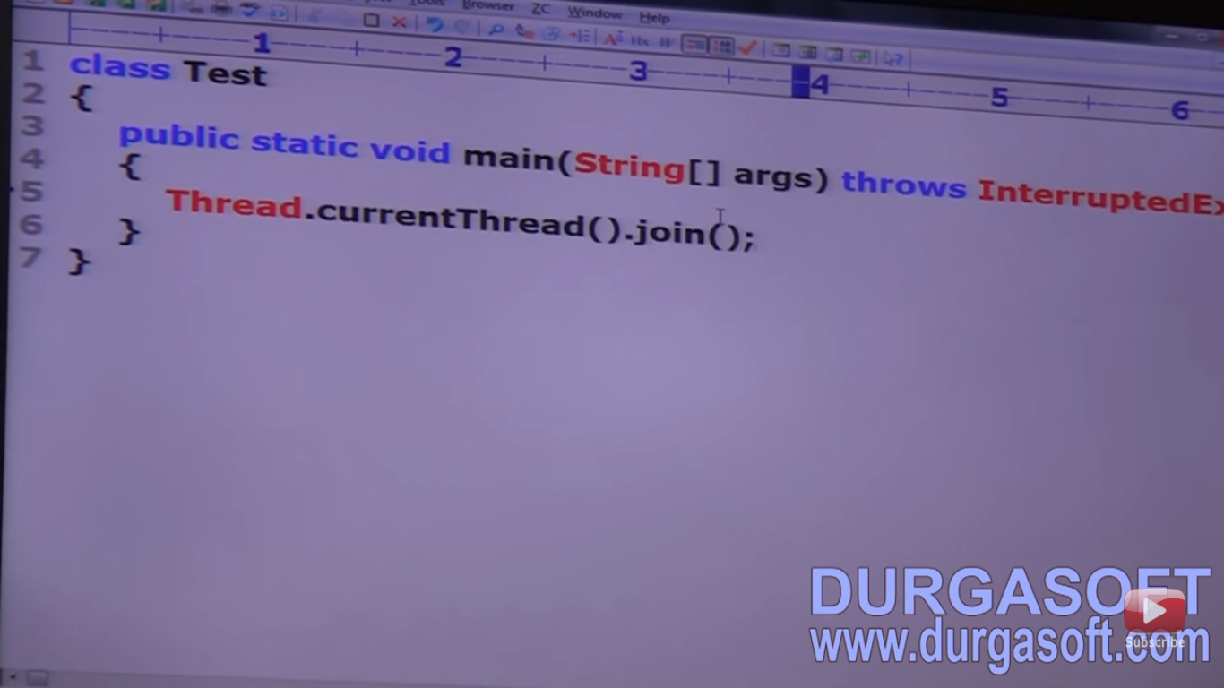

Slide 35
Sleep()
Don’t want to perform any operation for particular amt of time then we have to use sleep().

Slide 36


Slide 37


Slide 38
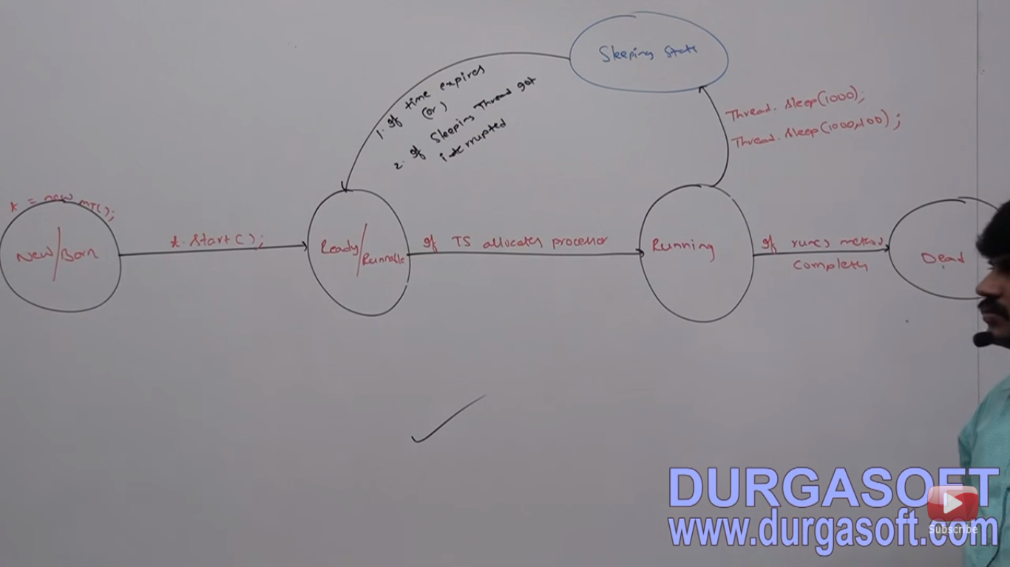

Slide 39
Interrupt()
Use to interrupt a waiting or sleeping thread.
Working like a snake. whenever we will sleep or wait it will interrupt.
Interrupt call will be waist if thread will not entered in its lifetime.

Slide 40


Slide 41
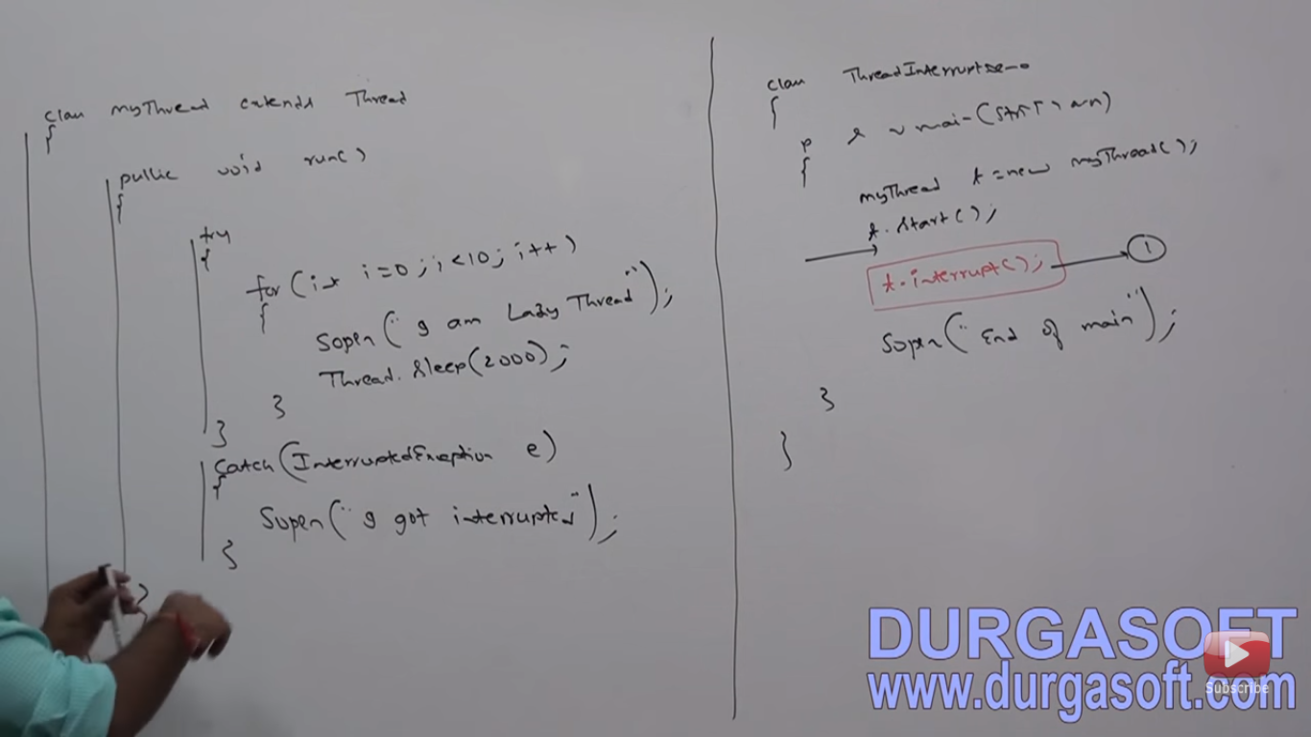

Slide 42


Slide 43
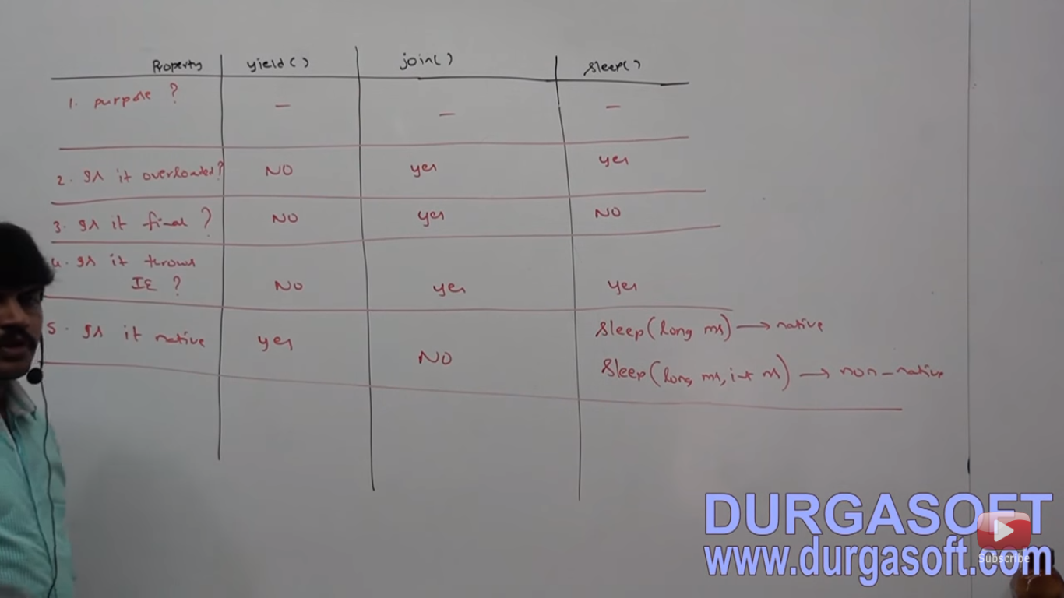

Slide 44
Synchronization
when multiple threads are using the same object then data inconsistence problem may occur.to overcome this problem we can use synchronized keyword with common information. then it will allow only one thread at a time.
Object(non-static synchronized resource block) and class level(static synchronized block ) both object lock & class lock can exist.
Modifier. applicable for methods and blocks.
It increases the waiting time and decreases the performance.

Slide 45


Slide 46
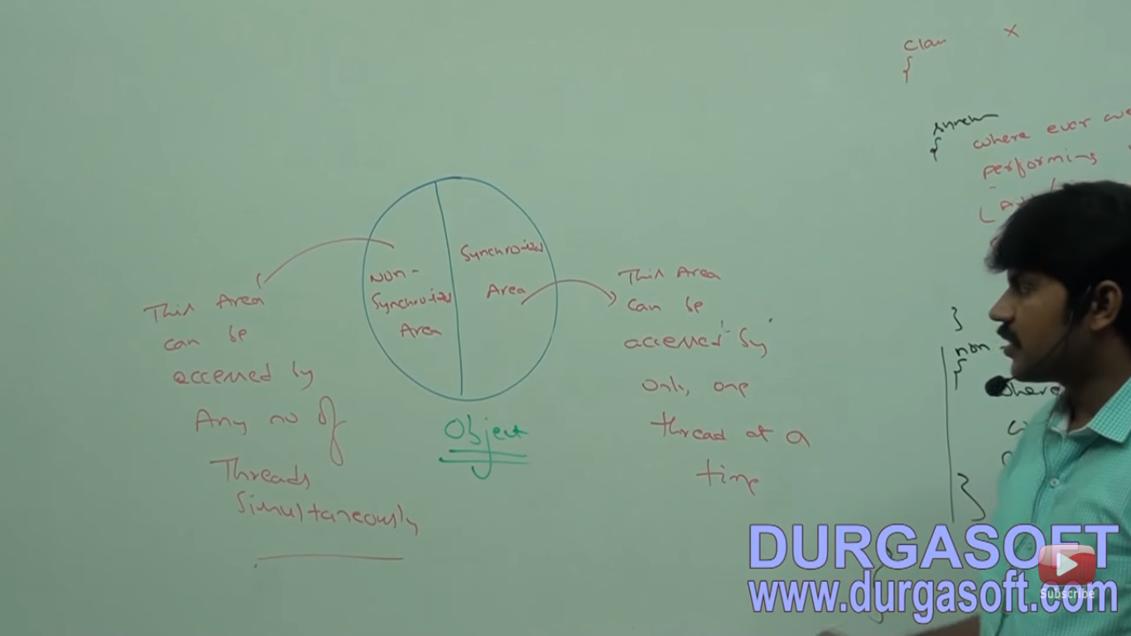

Slide 47


Slide 48


Slide 49
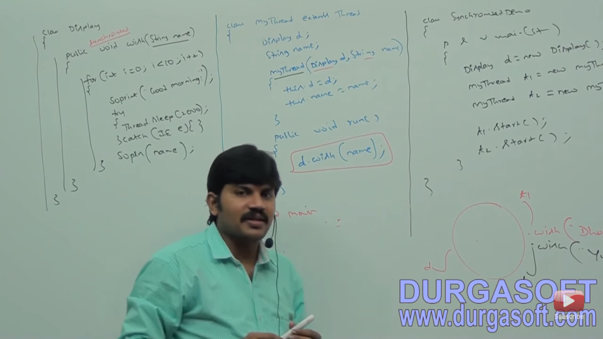

Slide 50


Slide 51


Slide 52


Slide 53
Need of synchronized block
If very few lines of code is required synchronization then we have to use block.Performance will increased.

Slide 54
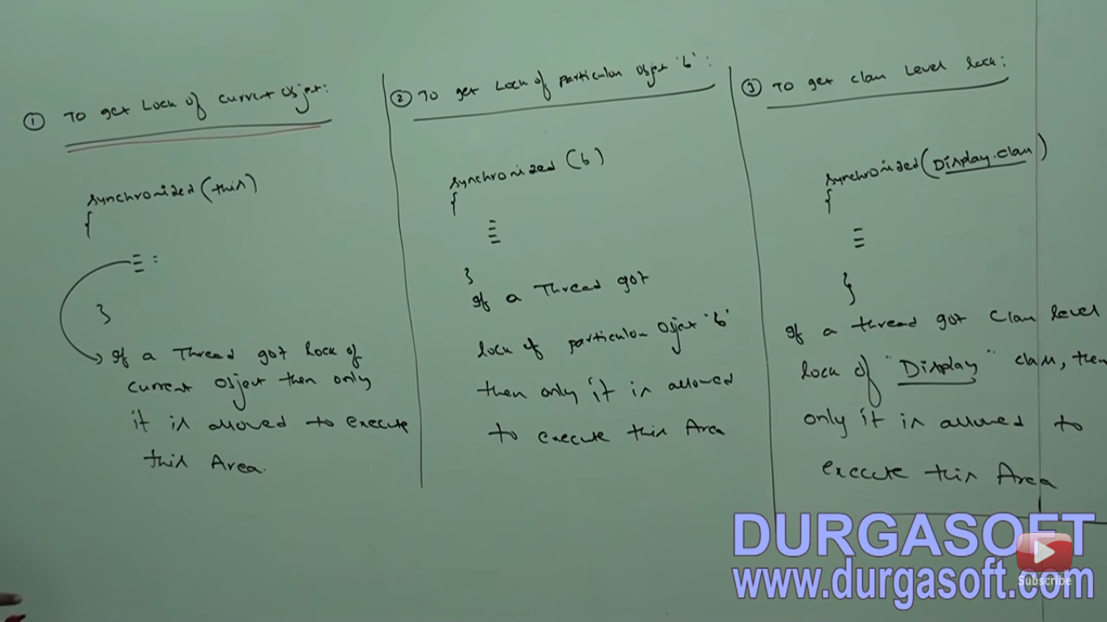

Slide 55
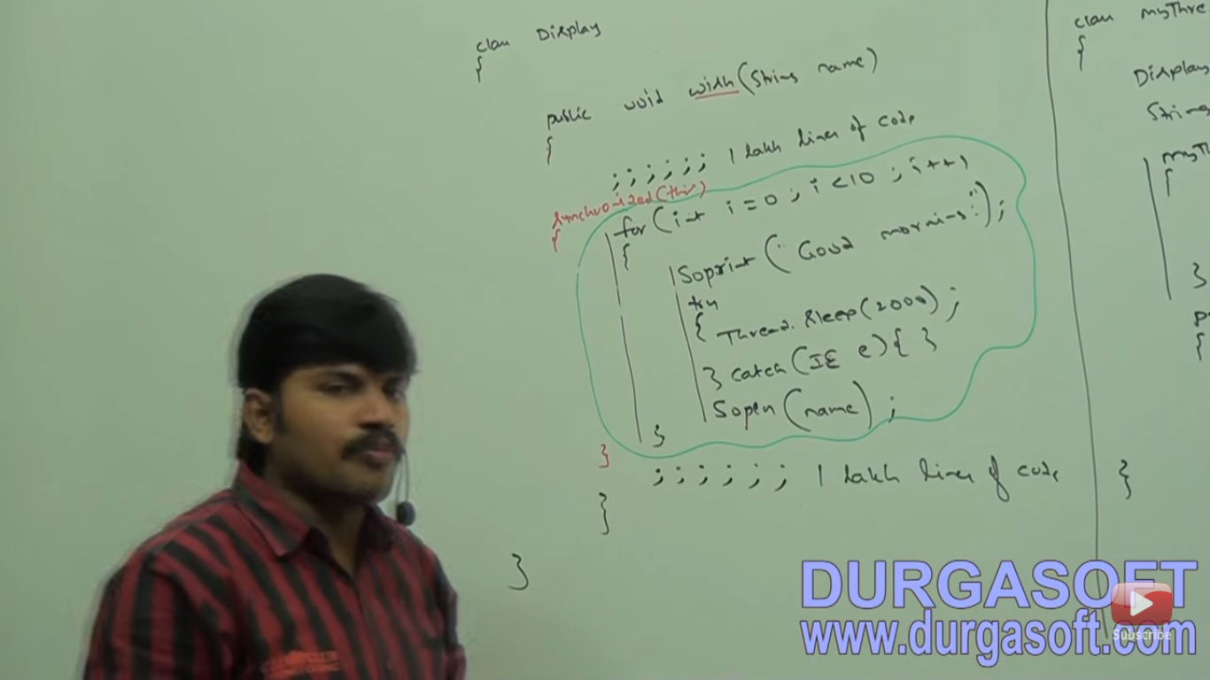

Slide 56
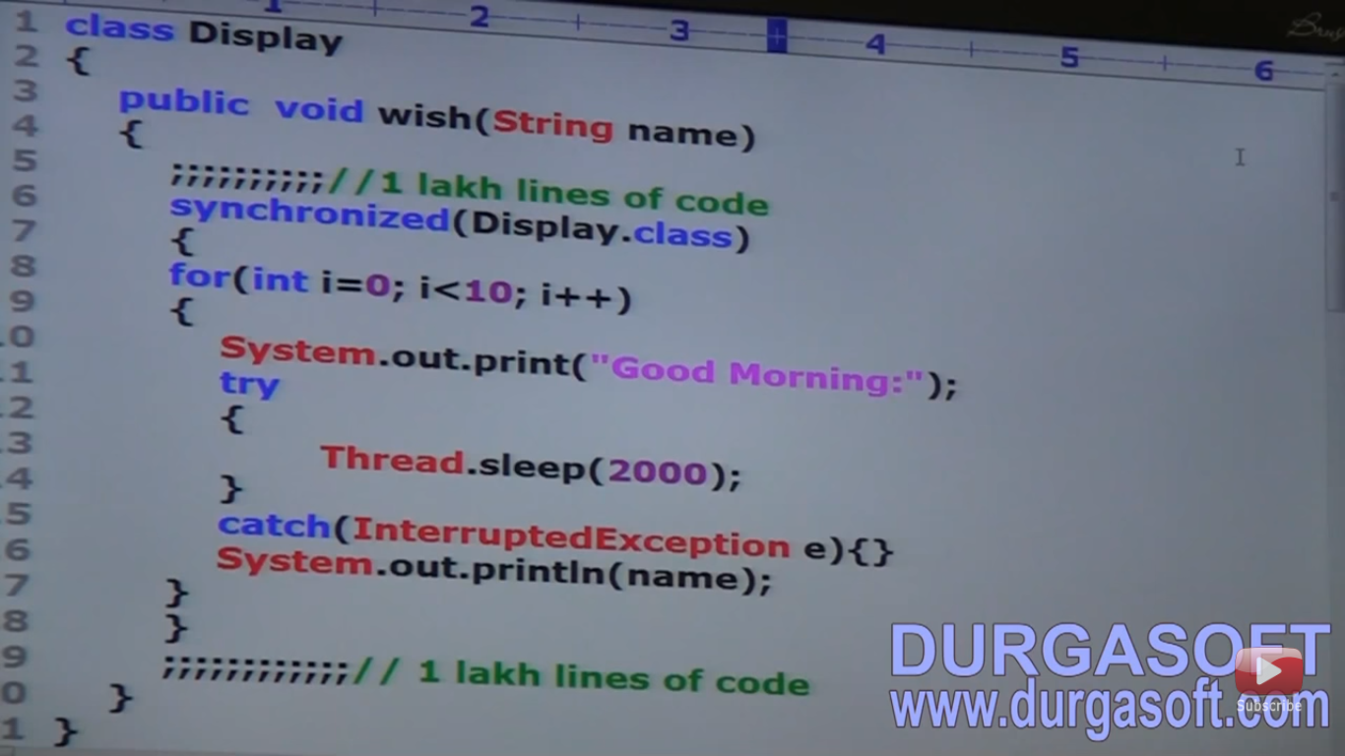

Slide 57


Slide 58
Race condition
when multiple threads are using the same object then data inconsistence problem may occur. this is the nothing but race condition.
Resolved by synchronized keyword.
A thread can acquire multiple locks of different objects.
Statement present in synchronized method and blocks are called synchronized statements.

Slide 59


Slide 60
Inter Thread Communication
Communication between two threads by using wait(),notify() and notifyAll().
A thread is waiting for updation of any other thread then it will call wait() method.Other thread will call notify() and notifyAll() after updation.
Present in Object class not in thread class because we are calling through object reference.
Call this method only in synchronized area otherwise it will throw illegalmonitorstate exception.
After calling wait() method then it will release particular object lock immediately and enter into waiting state.
After calling notify() method it may or may not release particular object lock immediately.

Slide 61


Slide 62


Slide 63


Slide 64


Slide 65
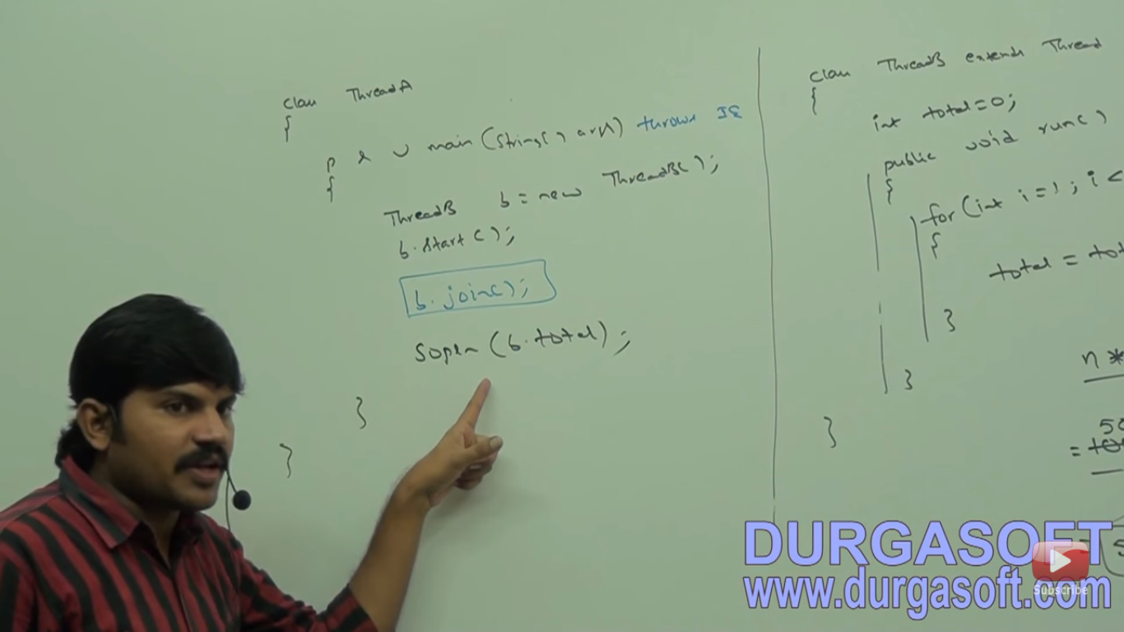

Slide 66


Slide 67
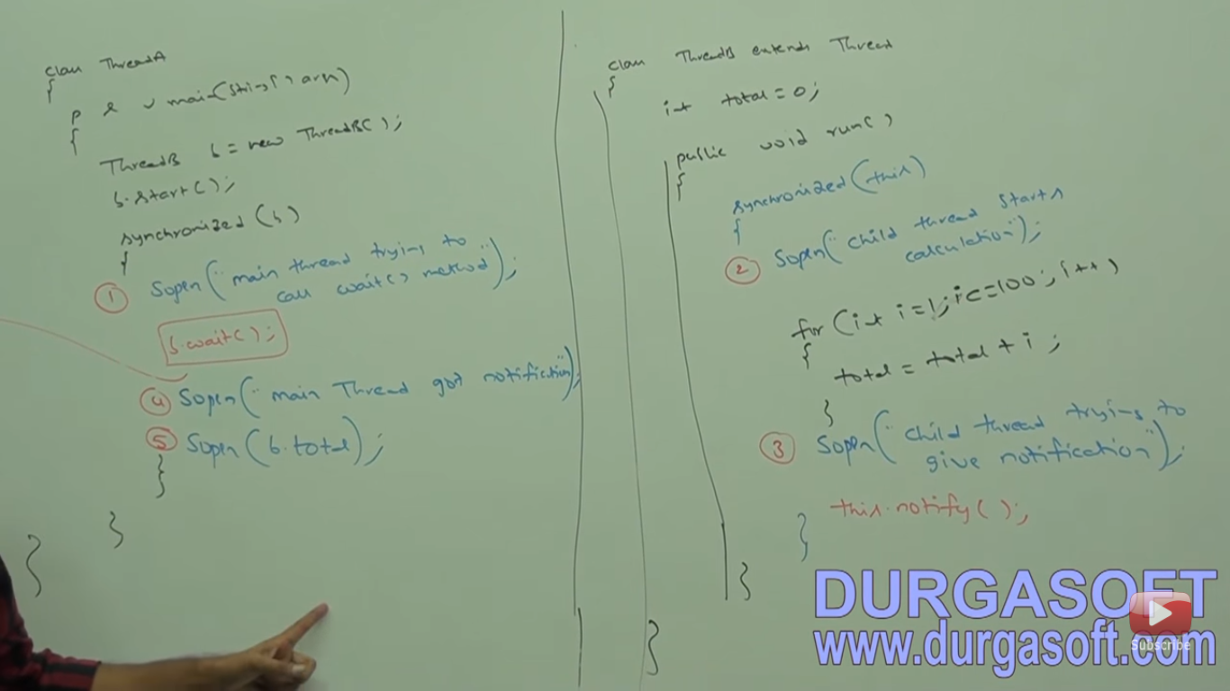

Slide 68
If no guarantee to get notification then we have to use wait(1000) with timeperiod.

Slide 69
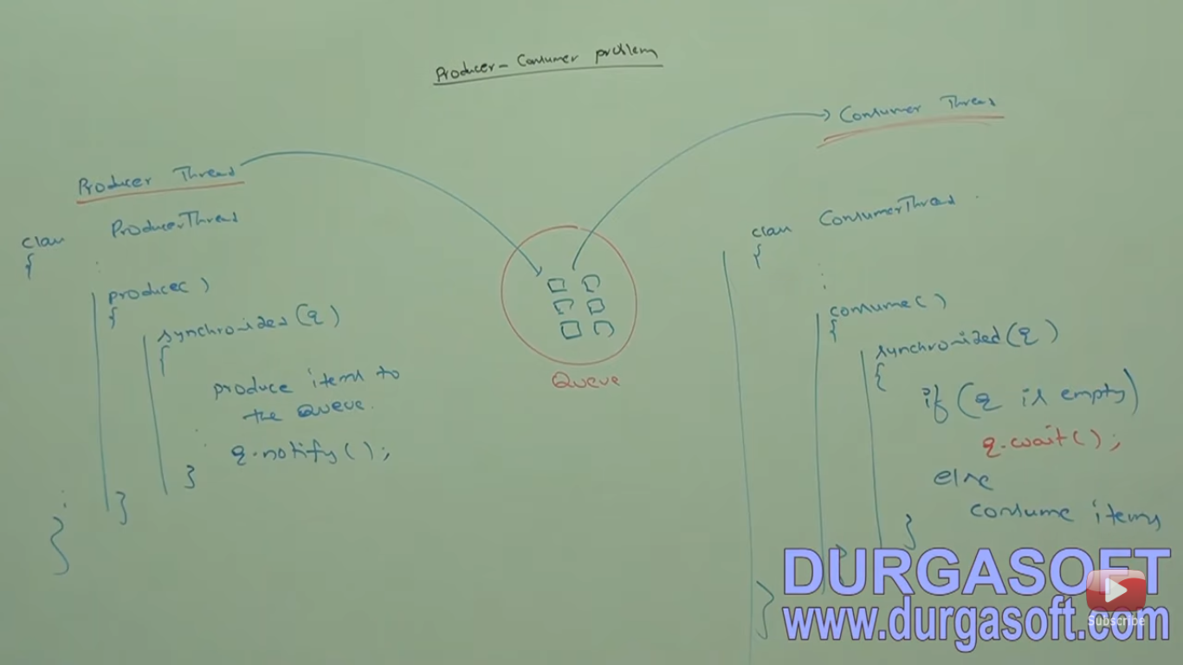

Slide 70
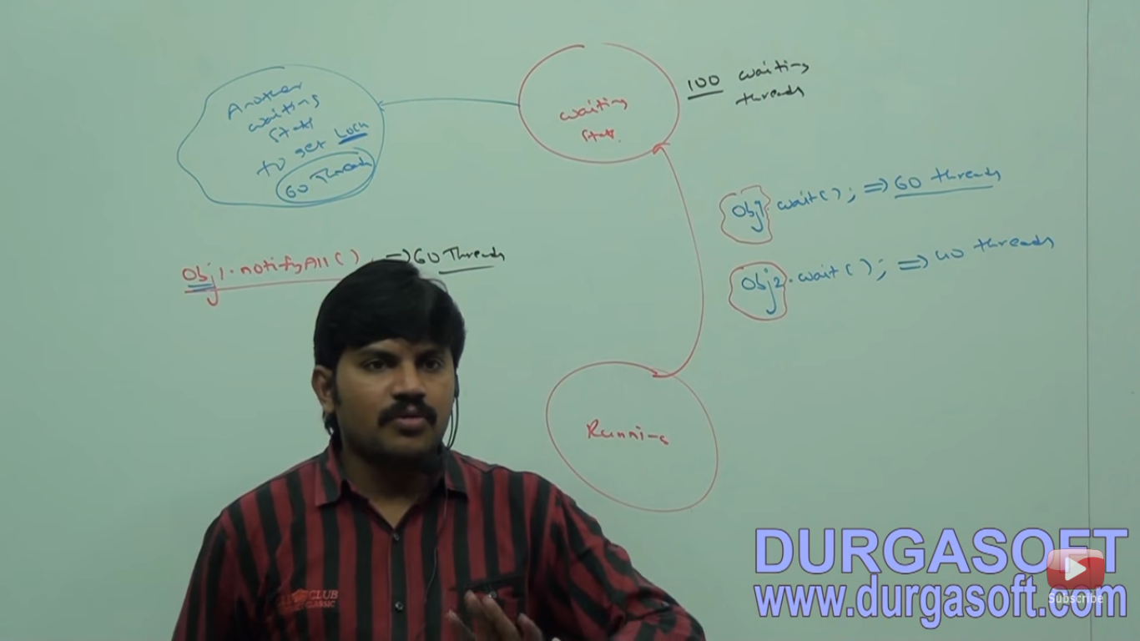

Slide 71
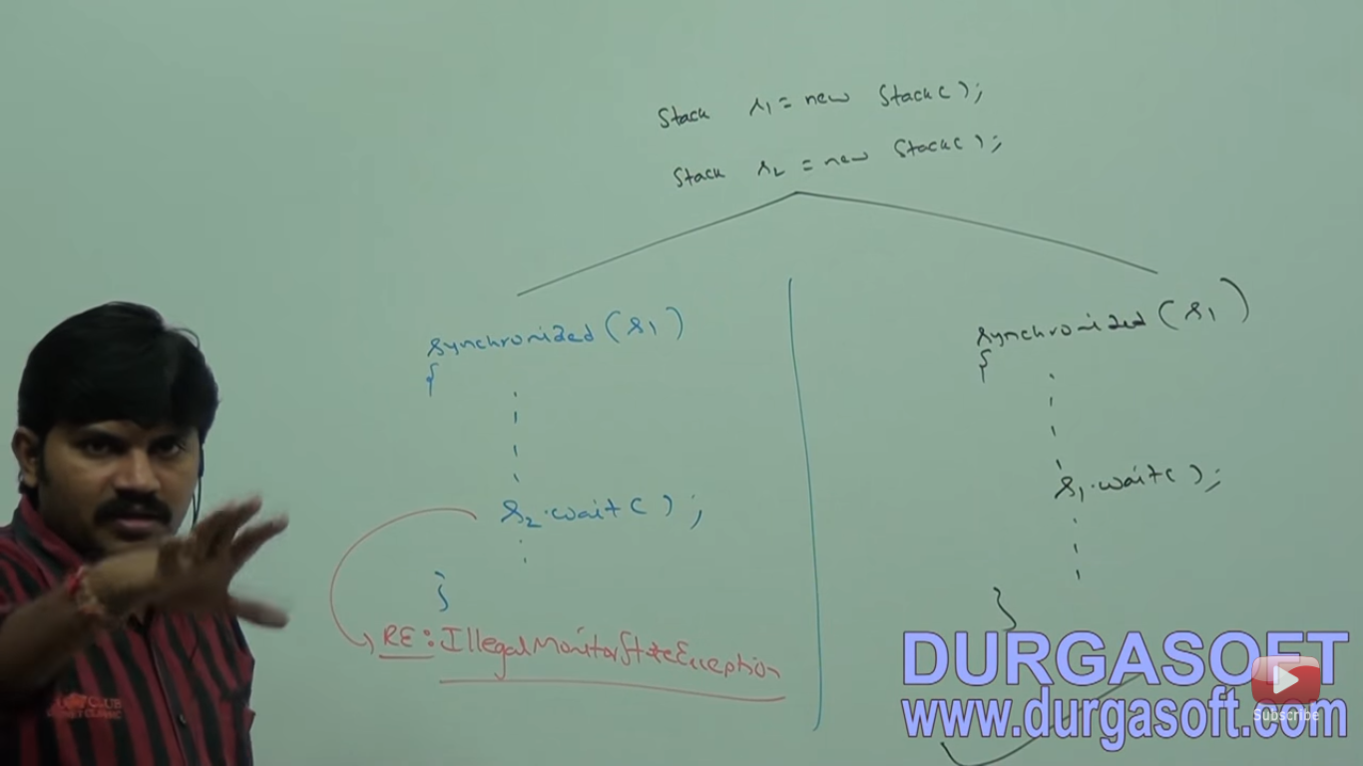

Slide 72
Deadlock
If two threads are waiting for each other forever then such type of infinite waiting is called deadlock.
Synchronized keyword is only reason for deadlock situation.
Hence while using Synchronized keyword we have to take special care.
No resolution techniques for deadlock but several prevention techniques are available like inter thread communication.

Slide 73


Slide 74
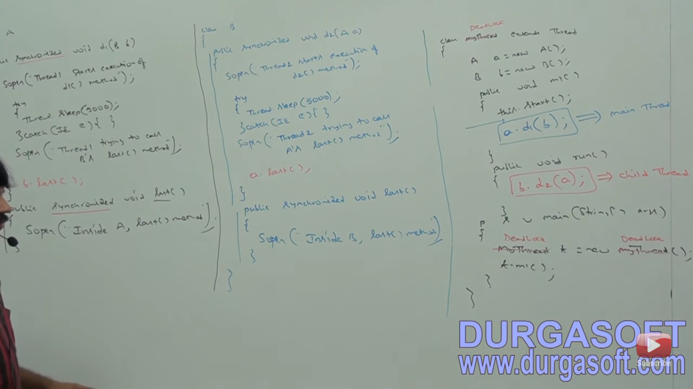

Slide 75
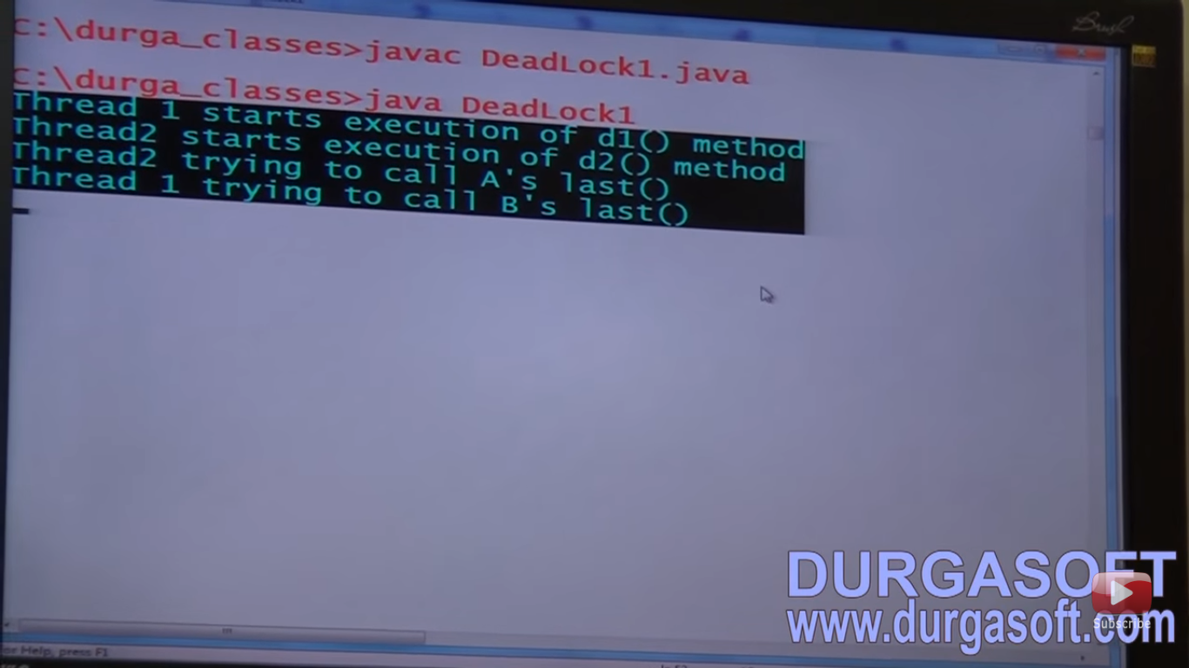

Slide 76
Deadlock vs starvation
Long waiting of a thread but waiting never ends is called deadlock.
Long waiting of a thread but waiting ends at certain point is called starvation.

Slide 77
Daemon Thread
Threads are executing in background that’s called daemon threads.
Main objective of daemon threads is to provide support for non-daemon threads(main thread).for example if main thread runs with low memory then JVM runs GC to destroy useless objects so that no of bytes of free memory will be improved. with this free memory main thread can continue it’s execution.
Usually daemon threads having low priority but based on our requirements daemon threads can run with high priority also.
After starting the thread we can not change the daemon nature otherwise it will throw exception like IllegalThreadStateExecption.
Two methods: isDaemon() ,setDaemon().

Slide 78


Slide 79
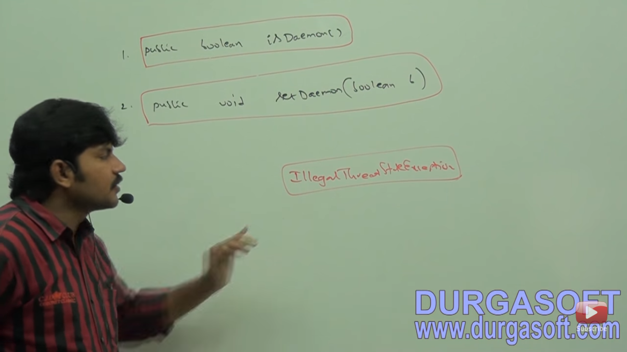

Slide 80
Default Nature of a Thread
By default main thread is always non-daemon.
For all remaining threads daemon nature will be inherited from parent to child that is if parent thread is daemon then automatically child thread is also daemon and viceversa.
It is impossible to change daemon nature of main thread because it is already started by JVM at beginning.
Whenever Last non-daemon threads terminates then all daemon threads are terminated automatically.

Slide 81


Slide 82


Slide 83
Thread Model
Multithreading is implemented using two model.
Green Thread Model - Completely managed by only JVM without taking underlying OS support. This is not recommended to use.eg-sun solaris.
Native OS Model: Thread life cycle is managed by JVM with taking underlying OS support.

Slide 84
How to Stop a Thread
We can stop a thread execution by using stop() method of thread class.Killing a thread in the middle of life, that is not recommended to use. So this is a deprecated method. Eg.JDBC operation.
If we call stop() method then immediately thread will enter into dead state.

Slide 85


Slide 86
Suspend() and resume()
Suspend means temporarily pause. then resume means continue the execution.
Enter into suspended state.
These methods are deprecated and not recommended to use.

Slide 87


Slide 88
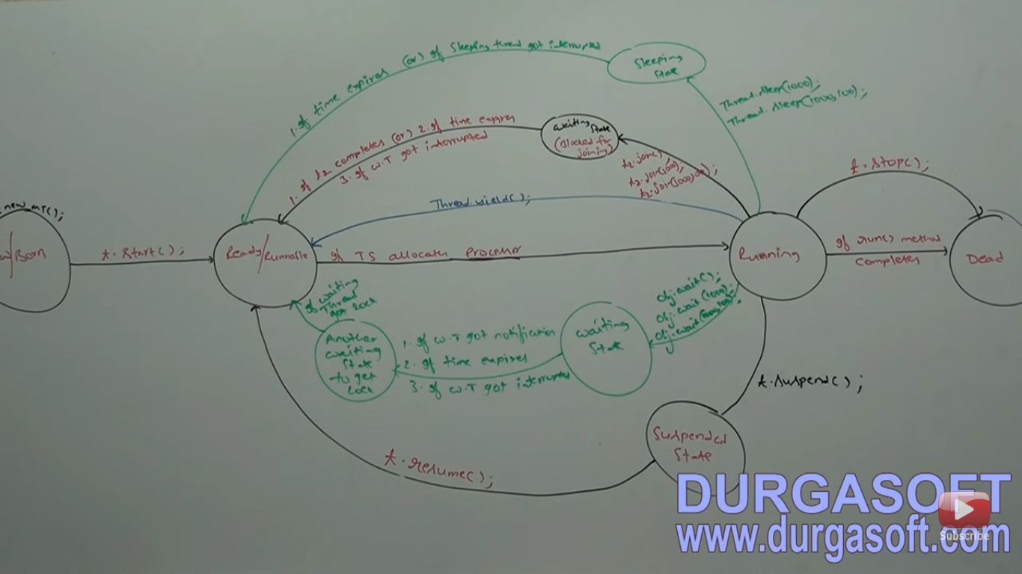

Slide 89
Thread Group
Thread group contain Group of threads Based on the functionality we can group threads into a single unit which is nothing but thread group.
Also contain sub thread groups.
Every thread in java belongs to some thread group.
main thread belongs to main group. Every thread group in java is child group of system group either or indirectly. So system group acts as root of all thread group in java.
System group contains several system level threads.eg GC, reference handler, signal dispatcher, Attach Listner etc.
Advantage is we can perform common operation very easily.
Present in java.lang pkg and direct child class of Object.

Slide 90


Slide 91
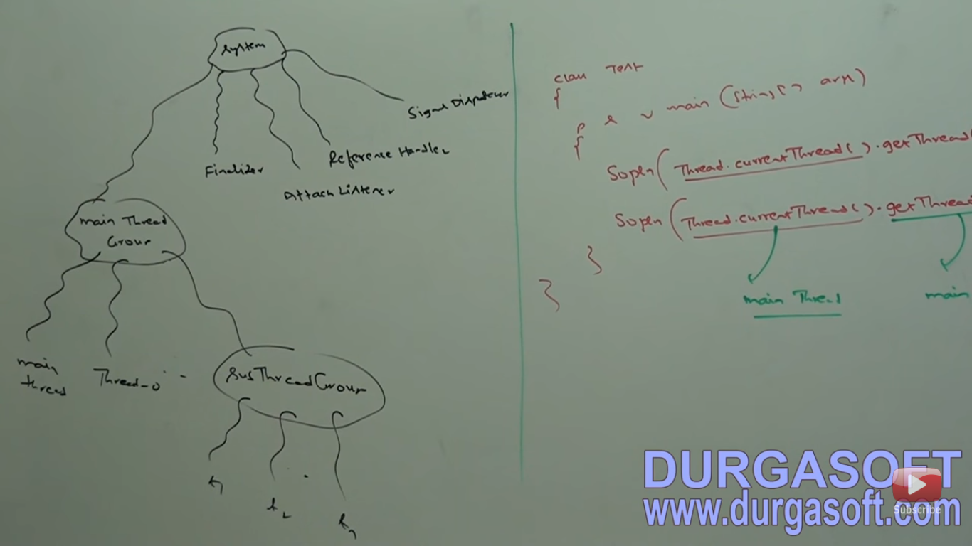

Slide 92
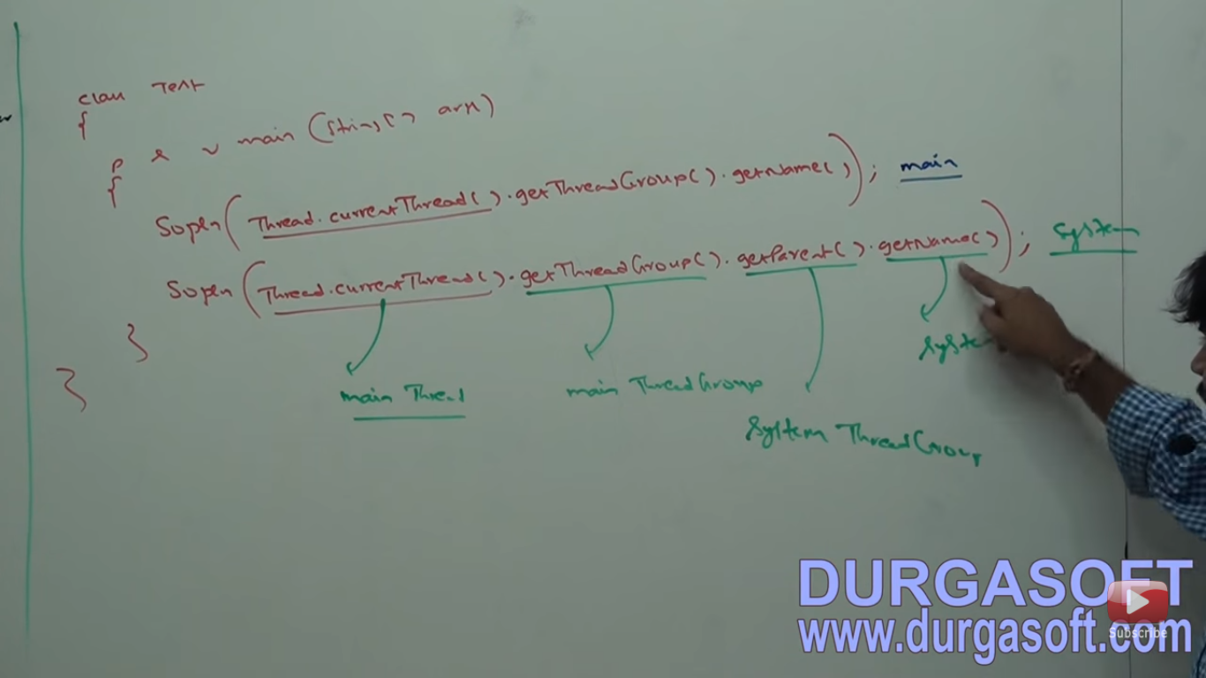

Slide 93
Constructors

Slide 94
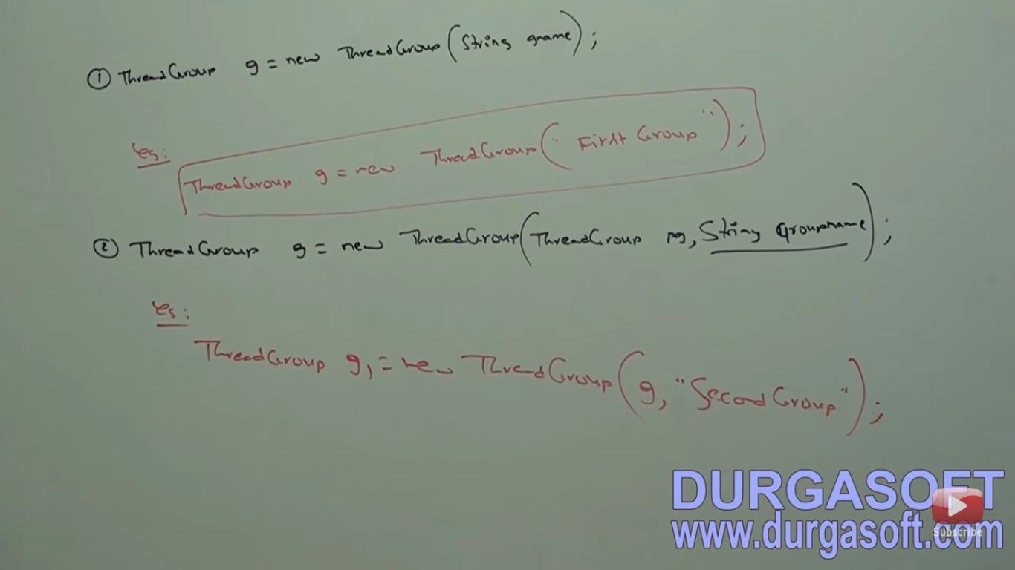

Slide 95
Methods in Thread Group

Slide 96
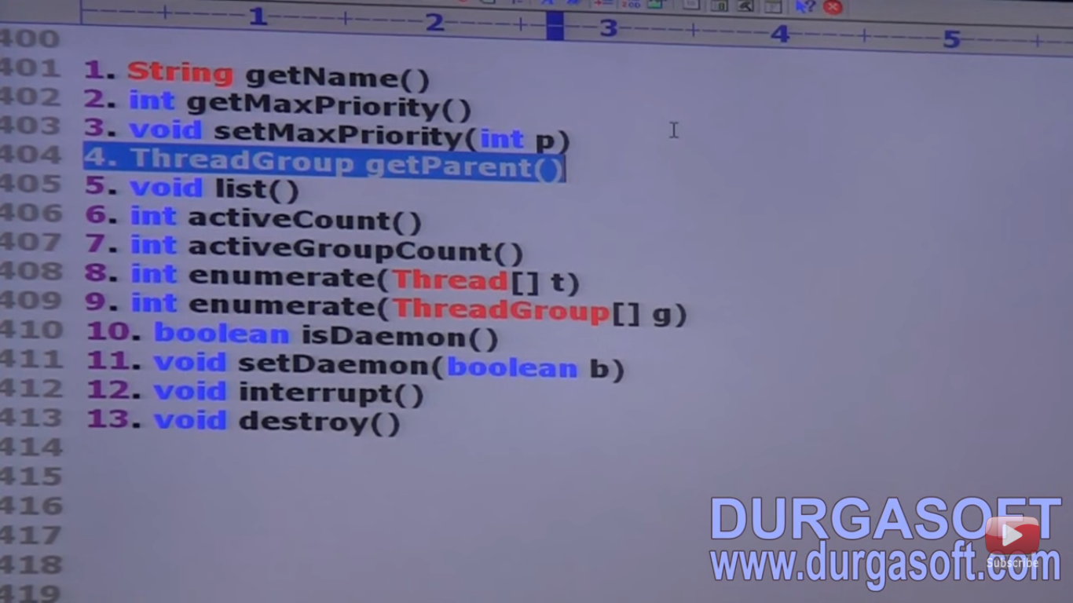

Slide 97
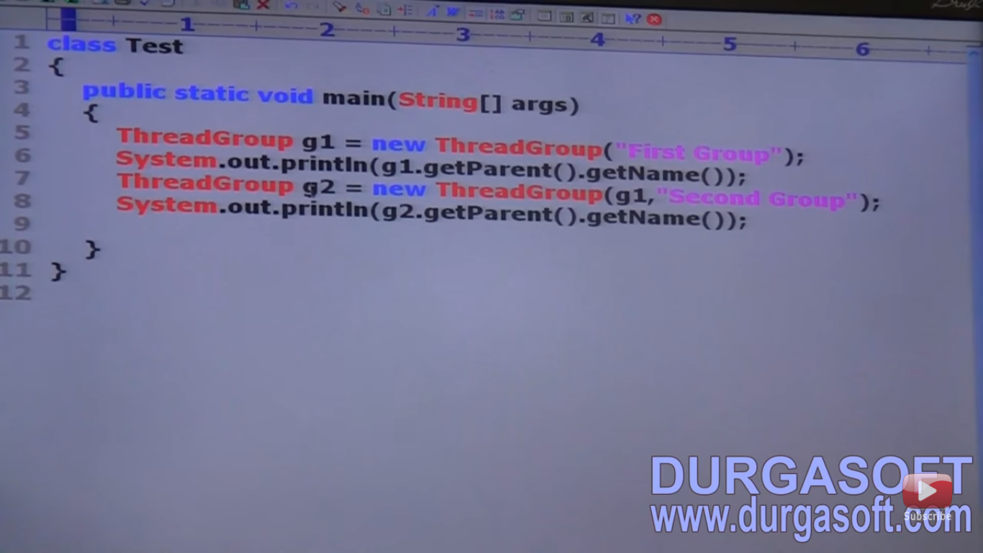

Slide 98
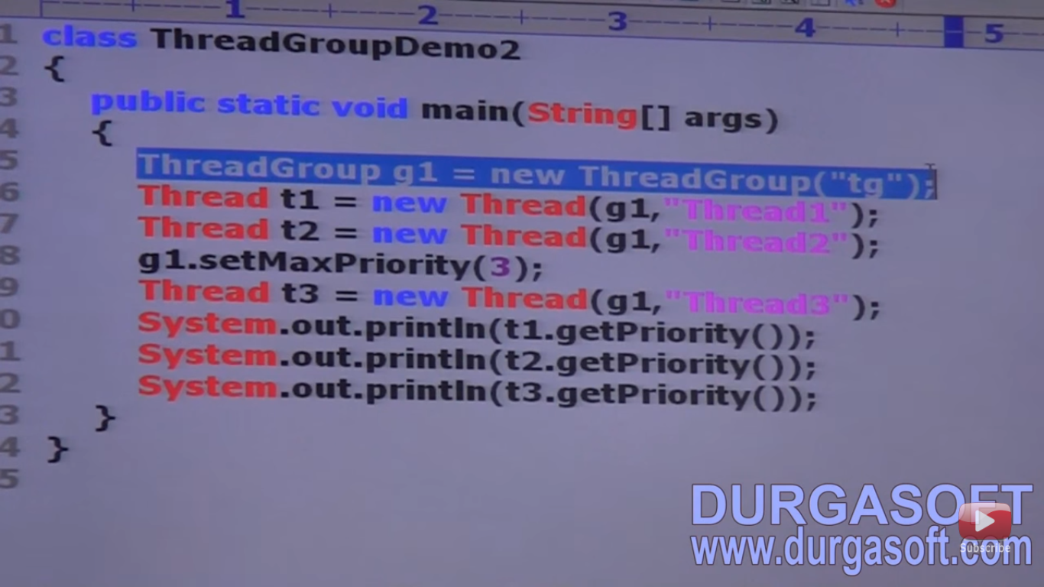

Slide 99


Slide 100
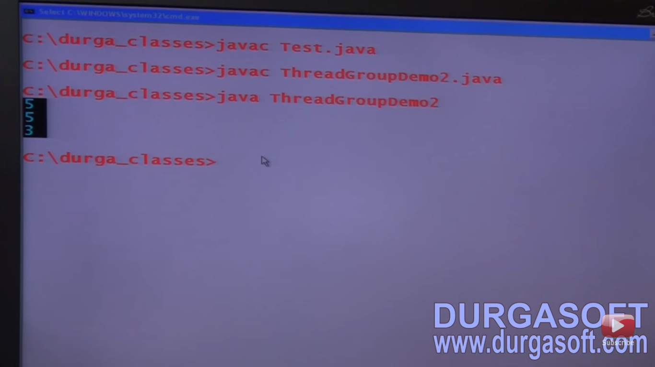

Slide 101
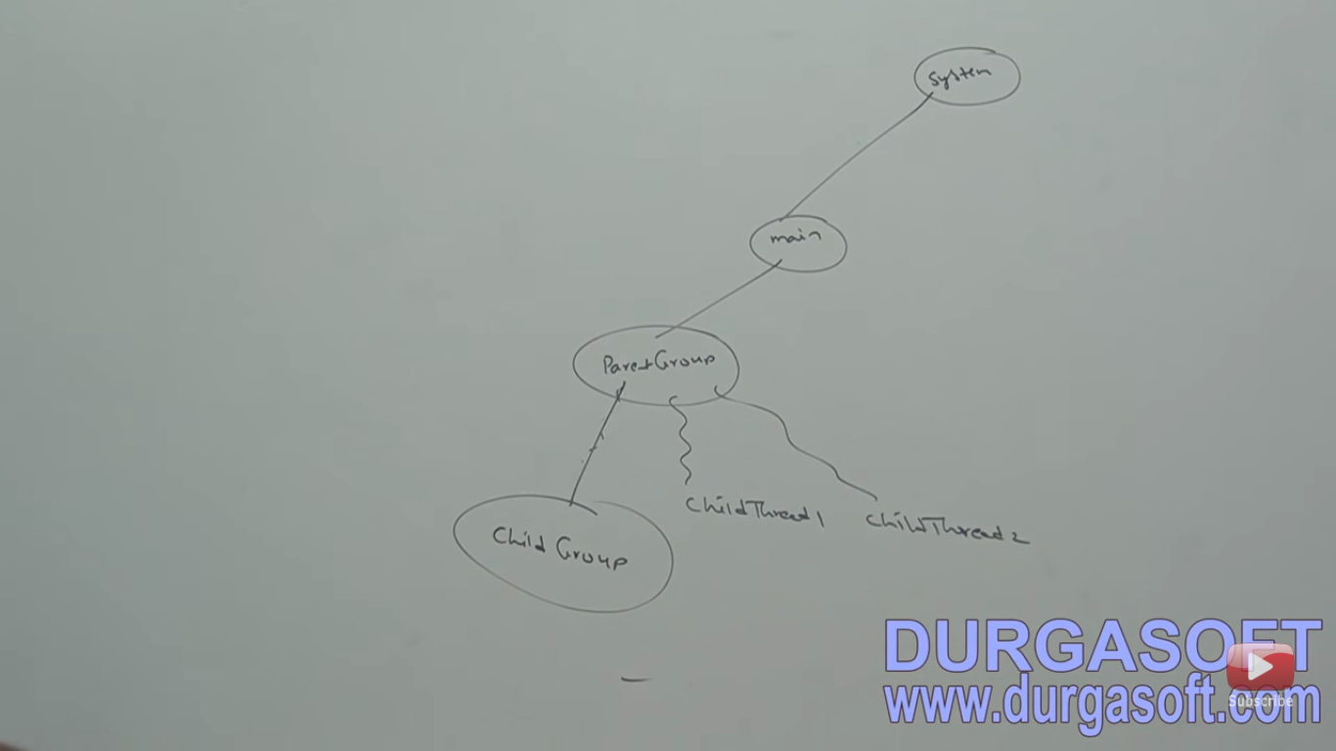

Slide 102
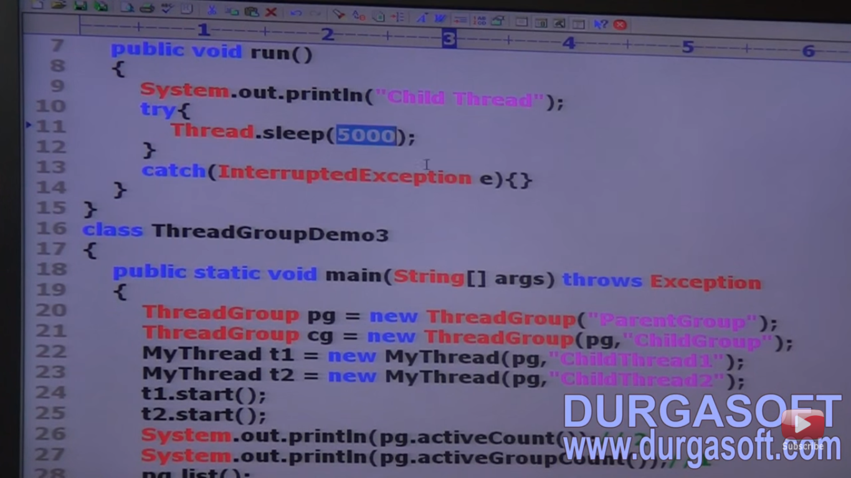

Slide 103
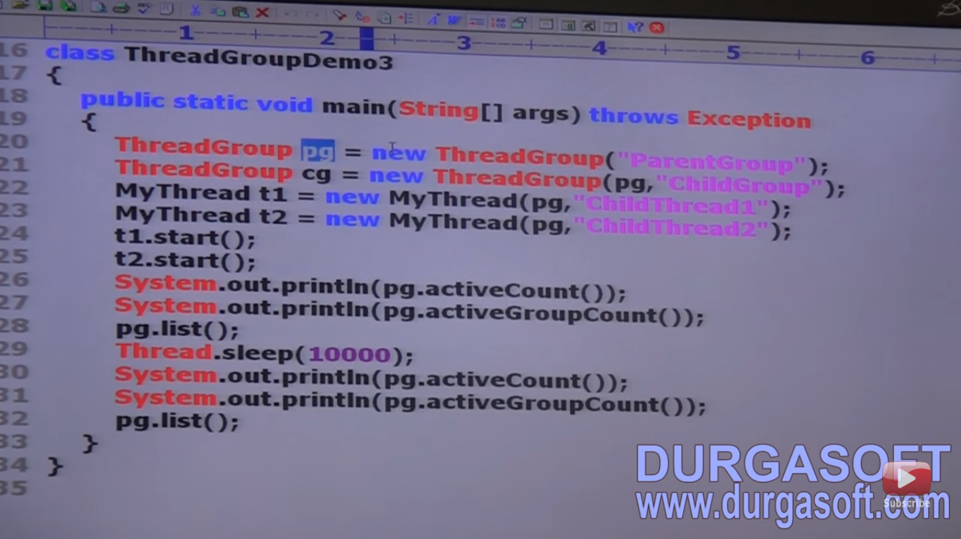

Slide 104
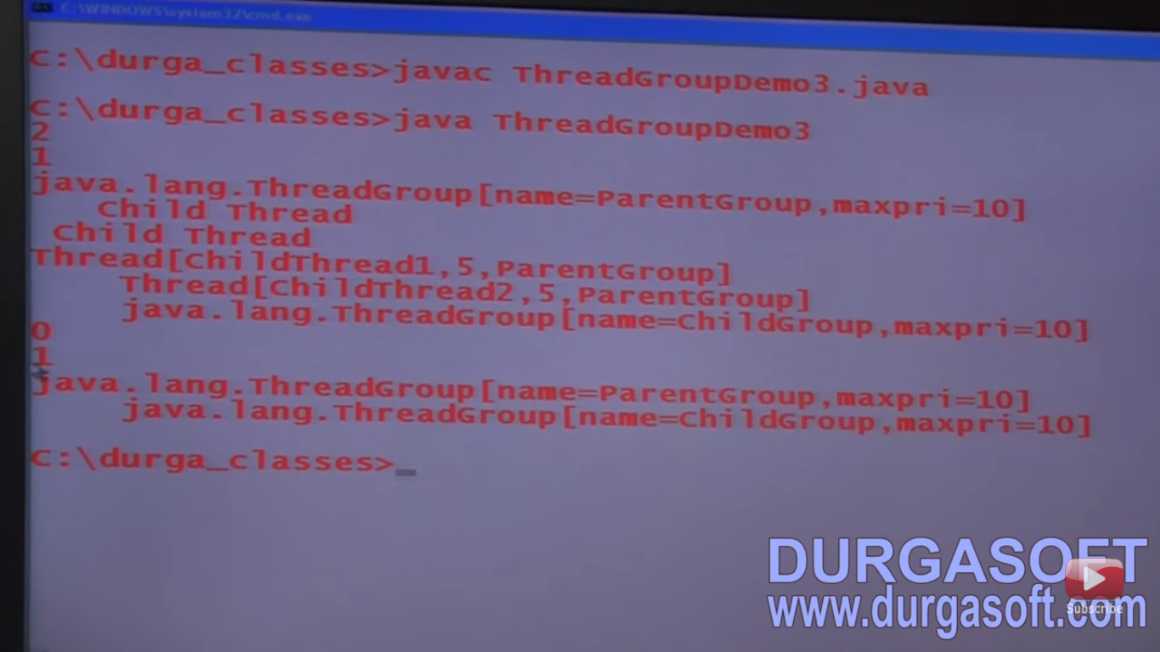

Slide 105
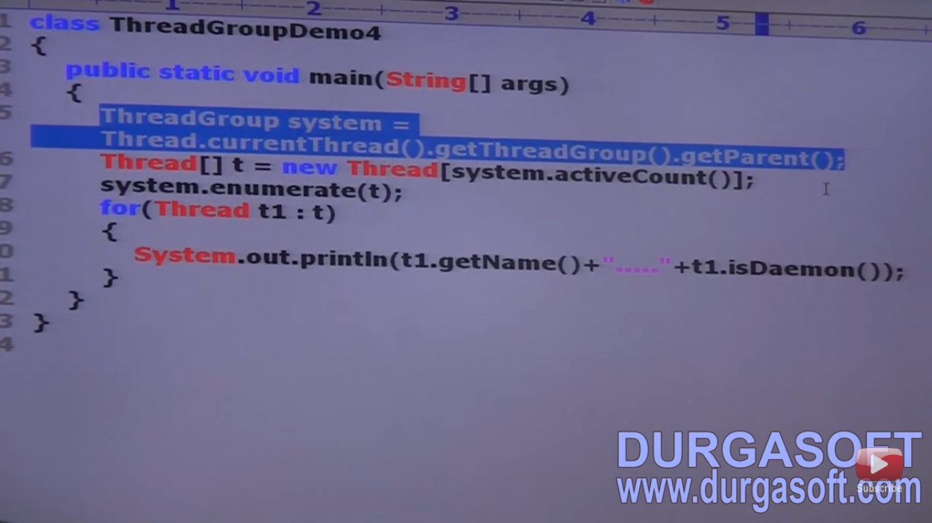

Slide 106
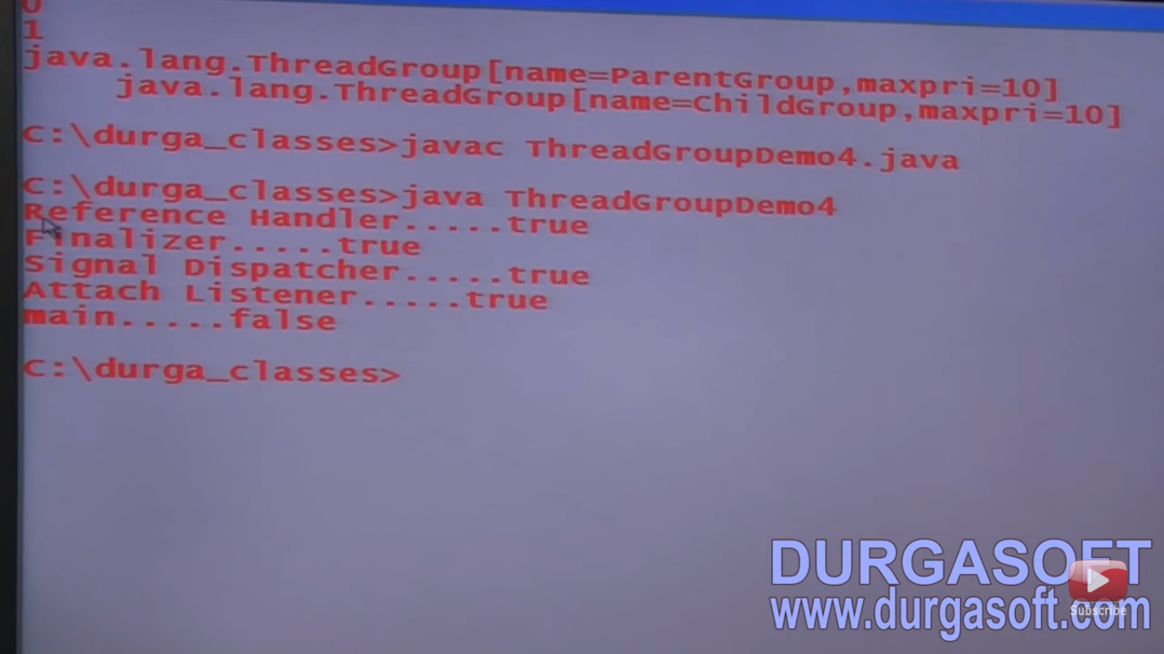

Slide 107
Java.util.concurrent
Problems in traditional synchronized keyword :
Using performance will go down because until getting the lock thread has to wait.no other options..
No way to specify the maximum waiting time to get the lock, which creates performance problem or deadlock.
Thread scheduler will decide that which waiting thread will get the lock.
we can not find the no of waiting threads for the lock.
Synchronized can use at method level and block level only.
Because of above reason java.util.concurrent pkg has come.
Here no need to wait. If thread will get lock then perform safe operation otherwise perform alternate operation using trylock() method.
Here fairness policy is there then we can decide which thread will get chance.
In traditional synchronized we can not find the no of waiting threads but here we can do.
Here we can use lock across multiple methods.
Came in 1.5v.

Slide 108
Lock interface
Lock object is similar to implicit lock acquired by a thread to execute synchronized method or block.
Lock implementation provide more extensive operations that traditional implicit locks.

Slide 109
Method of Lock Interface
Lock()
trylock()
trylock(timeperiod)
lockInterruptibly()
Unlock()

Slide 110


Slide 111
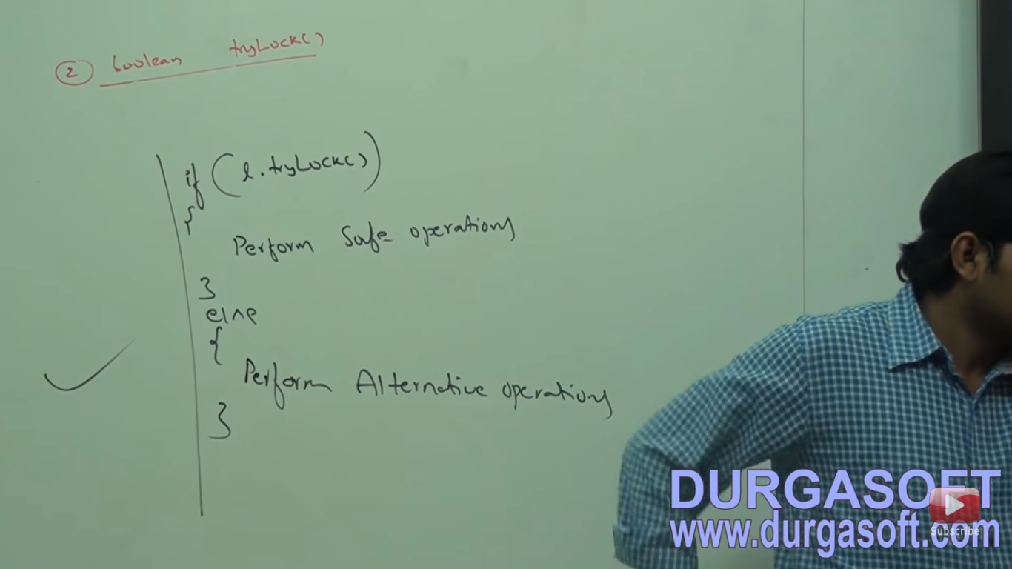

Slide 112


Slide 113
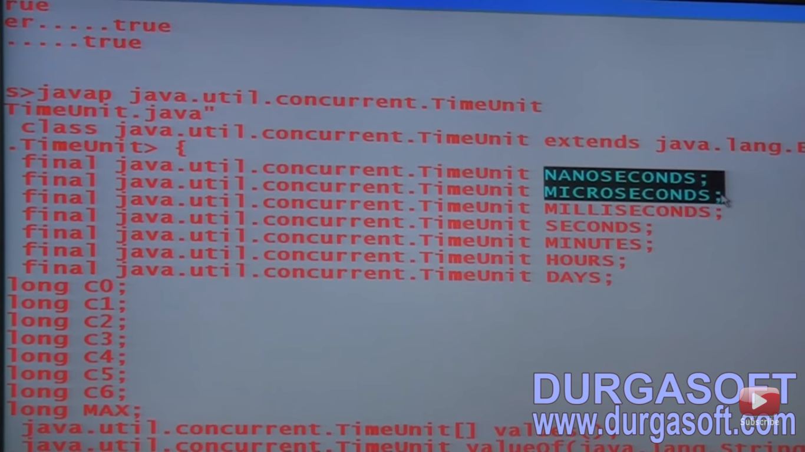

Slide 114


Slide 115
Waiting thread got interrupted then thread will not get a lock.
To call unlock(),current thread should be owner of the lock otherwise we will get exception IllegalMonitorStateException.

Slide 116


Slide 117


Slide 118
ReentrantLock class
Reentrant means again and again. Same thread can acquire same lock multiple times without any issue.
Internally lock will increment thread personal count whenever call lock() method and decrement personal count whenever call unlock() method. It release the lock when hold count will become zero.
It’s child class of object and implement Lock interface.

Slide 119
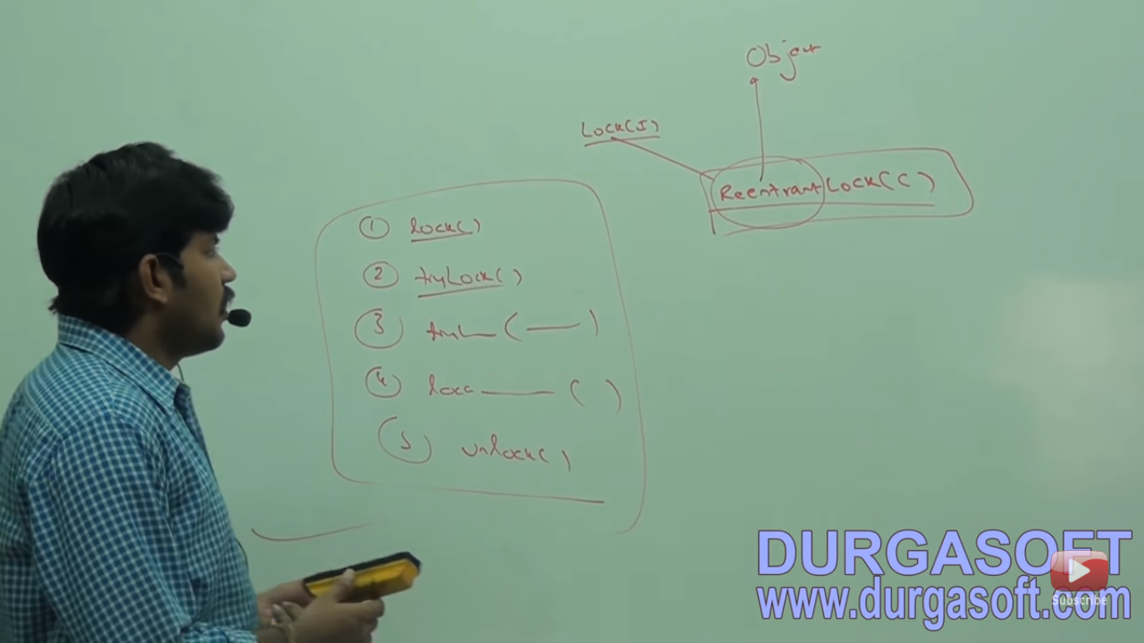

Slide 120


Slide 121
Constructor
No arg constructor.
Arg constructor with fairness(FCFS). If we set to true then longest waiting thread can get the lock if it is available. if fairness is false then which waiting thread will get the chance we can’t except.
Default value for fairness is false.

Slide 122
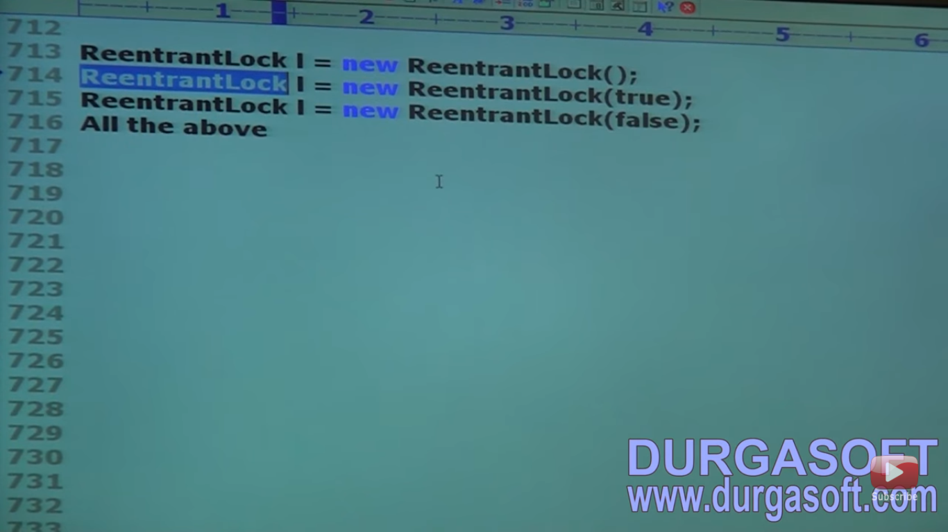

Slide 123
Methods of ReentrantLock

Slide 124
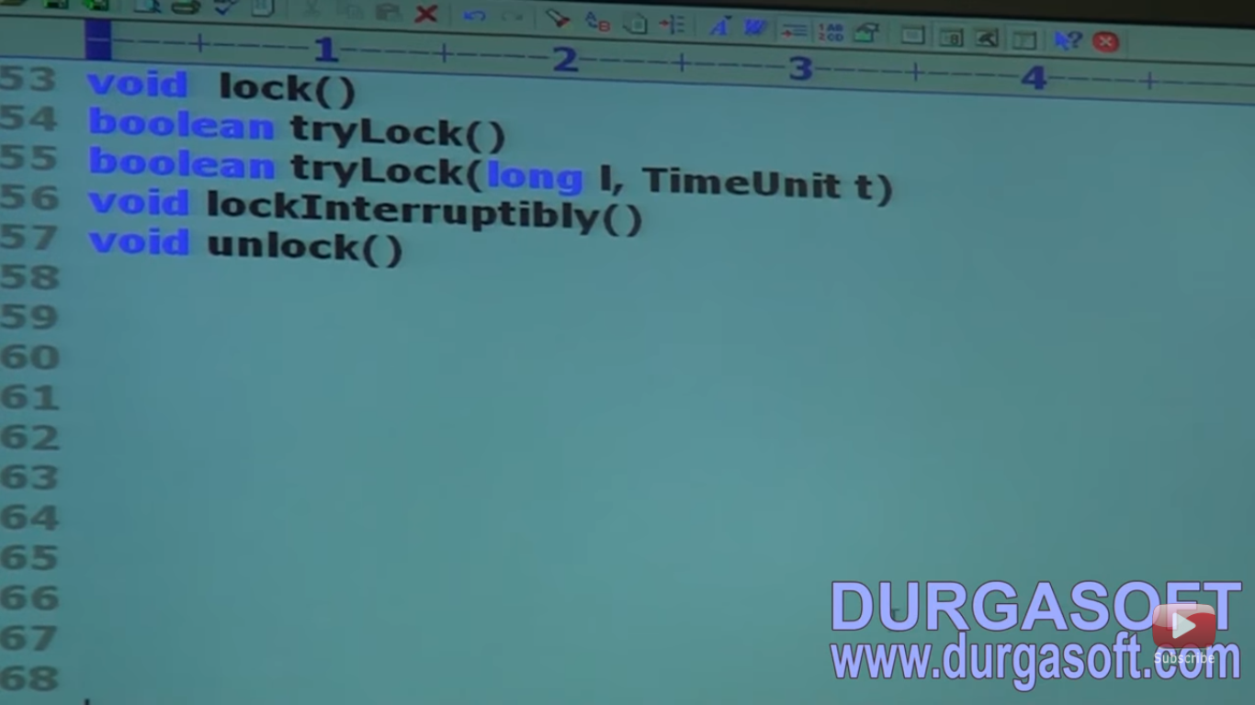

Slide 125


Slide 126


Slide 127


Slide 128


Slide 129


Slide 130


Slide 131


Slide 132


Slide 133


Slide 134
Thread Pools(Executor Framework)
Creating a new thread for every job may create performance and memory problems.
To overcome this we should go for thread pool.
Thread pool is pool of already created threads ready to do our jobs.
Java 1.5v introduces Thread pool framework to implement thread pools.
Thread pool framework also known as executor framework.
By developing webserver or application server we have to implement thread pool concept.Default pool size of webserver or application server are 60.

Slide 135


Slide 136


Slide 137


Slide 138


Slide 139


Slide 140


Slide 141
Runnable,Callable and future
Runnable thread does not return any value but callable must return some values.
Runnable present in java.lang but callable present in java.util.concurrent pkg.
Future object is used to hold the return value from callable jobs.

Slide 142


Slide 143


Slide 144


Slide 145


Slide 146


Slide 147
Thread Local class
Provides thread local variables.
Thread Local Class maintains values per thread basis. each thread local object maintain a separate value like user id, transaction id etc. For each thread accesses its local values, can manipulate its value or even can remove its value.
In every part of the code which is executed by thread we can access it’s local variable.
Consider a servlet which invokes some business methods. we have a requirement to generate a unique transaction ID for each and every request and we have to pass this transaction ID to business methods. For this requirements we can use thread local to maintain a separate transaction ID for every request that is for every thread.
Introduced in 1.2v.
Thread local can be associated with thread scope.
Total code which is executed by thread has acess to thread local variable.
A thread can access it’s own local variable and can’t access other threads local variables.
Once thread enter into dead state then all it’s local variable by default eligible for GC.

Slide 148
Constructors

Slide 149


Slide 150
Methods
Set(),get(),remove(),initialValue()

Slide 151


Slide 152


Slide 153


Slide 154


Slide 155
Thread Local Vs InheritableThreadLocal
Parent thread local variable does available for child thread.
For that we have to go for InheritableThreadLocal then child local value will be same as parent local thread value . For different value we have to override childValue() method.

Slide 156


Slide 157
Methods

Slide 158


Slide 159


Slide 160


Slide 161


Slide 162


